Slide 1
Design and Implementation of Virtual Memory Management in C
An In-depth Exploration of Paging, Page Tables, and Page Fault Handling
Monish kumaar-192225014
Sai kiran-192225083

Slide 2
Abstract
In modern computing, the efficiency and performance of operating systems heavily rely on their ability to manage memory effectively. Virtual Memory Management (VMM) is a crucial subsystem that abstracts physical memory to provide a larger, more flexible memory space for applications. This paper presents the design and implementation of a simplified Virtual Memory Management System in C, focusing on core concepts such as paging, page tables, and page fault handling. The proposed system emulates the virtual-to-physical address translation process and provides a basic framework for understanding how operating systems manage memory. Key components include a simulated physical memory space, a backing store for handling page faults, and a page table structure for mapping virtual pages to physical frames. The system demonstrates the fundamental principles of VMM, such as address translation, page table management, and the handling of page faults when a page is not resident in physical memory.

Slide 3
INTRODUCTION:
In the realm of modern computing, memory management stands as a cornerstone of operating system design, pivotal for enabling efficient and effective resource utilization. As applications grow increasingly complex and resource-intensive, managing physical memory becomes a critical challenge. Virtual Memory Management (VMM) is an advanced solution to this challenge, providing a seamless and flexible approach to memory allocation that extends beyond the limitations of physical hardware. VMM creates an abstraction layer that allows the operating system to present a large, continuous address space to applications, even if the underlying physical memory is fragmented or insufficient. This abstraction not only simplifies programming but also enhances system stability and performance by isolating processes, thus preventing them from interfering with each other. By employing techniques such as paging and segmentation, VMM efficiently maps virtual addresses to physical addresses, optimizing memory usage and access times. Additionally, VMM handles memory shortages gracefully through mechanisms like paging and swapping

Slide 4
Virtual Memory Management
It is the physical memory to create an illusion of a vast and continuous address space available to applications. This abstraction allows systems to execute processes that require more memory than what is physically available, thus enabling multitasking, enhanced performance, and improved system stability
At the heart of virtual memory systems are several key concepts:
Paging: This technique divides the virtual address space into fixed-size pages and maps them to physical memory frames. Paging eliminates the need for contiguous memory allocation,
Page Tables: These data structures maintain the mapping between virtual pages and physical frames. Each entry in a page table includes a reference to a physical frame and status bits indicating whether the page is present in physical memory.
Page Fault Handling: When a process accesses a page not currently in physical memory, a page fault occurs. The operating system responds by fetching the required page from a secondary storage (backing store) and updating the page table to reflect the new mapping.

Slide 5
PROCESS:
Designing and implementing a Virtual Memory Management (VMM) system involves several key steps, from understanding fundamental concepts to creating a functional simulation. Below is a detailed step-by-step guide to developing a simplified VMM system in C. This guide covers the project from inception through to execution and testing. Here is the step by step process:
Step 1: Understand the Fundamentals of Virtual Memory
Step 2: Define the Project Scope and Constraints
Step 3: Design the System Architecture
Step 4: Implement the Data Structures
Step 5: Initialize the System
Step 6: Compile and Run the Program
Step 7: Evaluate and Extend.

Slide 6
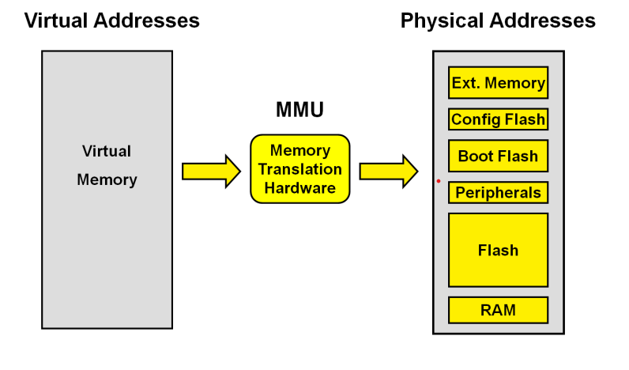

Slide 7
OBJECTIVES
The primary objective of a Virtual Memory Management (VMM) system is to efficiently manage the computer’s memory resources, providing each process with the illusion of a large, contiguous address space while ensuring optimal use of the physical memory. This involves the abstraction of physical memory into a more extensive virtual address space, allowing the execution of programs that require more memory than what is physically available. The VMM system aims to achieve several critical goals: to isolate and protect processes, ensuring that each operates within its own virtual space without interfering with others; to enable multitasking by dynamically allocating and deallocating memory as needed by different processes; and to handle memory shortages gracefully through techniques like paging and swapping, which load and unload memory pages between physical memory and secondary storage. Additionally, the system seeks to optimize performance through efficient address translation mechanisms and effective page replacement strategies, minimizing the overhead and latency associated with memory management. Ultimately, the VMM system is designed to maximize system stability and performance, providing a robust foundation for running diverse and complex applications in a secure and resource-efficient manner.

Slide 8
Applications of VMM:
1. Multitasking:Efficient Process Management: Allows multiple processes to run concurrently by providing each with its own virtual address space.
2. Enhanced System Stability:Memory Isolation: Protects the memory of each process from being accessed or modified by others.Fault Tolerance: Handles errors gracefully by isolating faults to specific processes, preventing system-wide crashes.
3. Optimized Resource Utilization:Dynamic Allocation: Allocates memory on demand, optimizing the use of available physical memory.Memory Overcommitment: Allows the system to allocate more memory to applications than is physically available, using techniques like paging and swapping.
4. Support for Large Applications:Extended Address Space: Enables applications to use more memory than the physical hardware limitations by providing a larger virtual address space.
5. Improved Performance:Efficient Memory Access: Reduces latency and improves access times through techniques like demand paging and prefetching.

Slide 9
Recent Developments and Future Directions
Recent advancements in VMM research focus on optimizing performance in multi-core and multi-processor environments, addressing the challenges of managing memory in systems with heterogeneous architectures, and improving the efficiency of virtual memory systems for applications with large memory footprints, such as big data analytics and machine learning workloads . Techniques like transparent huge pages (THP) and memory compression are being explored to improve memory management efficiency and reduce latency. THP combines smaller pages into larger ones to reduce the overhead of managing numerous page table entries, while memory compression techniques aim to increase the effective memory capacity by compressing the data stored in memory .

Slide 10
CONCLUSION
Virtual Memory Management (VMM) systems are integral to the functionality and efficiency of modern computing environments. By abstracting physical memory and providing each process with its own virtual address space, VMM enables the execution of large and complex applications, enhances system stability, and improves overall resource utilization. This approach allows operating systems to maximize the use of physical memory, supporting multitasking and isolating processes to ensure security and reliability. Through the implementation of core VMM components such as paging, page tables, and page fault handling, operating systems can manage memory dynamically, loading only the necessary pages into physical memory and handling memory shortages gracefully. These mechanisms not only optimize the performance of individual applications but also contribute to the seamless operation of the system as a whole, even under varying and demanding workloads.

Slide 11
REFERENCES:
Kilburn, T., Edwards, D.B.G., Lanigan, M.J., & Sumner, F.H. (1962). One-level storage system. IRE Transactions on Electronic Computers, EC-11(2), 223-235.
Denning, P.J. (1970). Virtual memory. ACM Computing Surveys (CSUR), 2(3), 153-189.
Denning, P.J. (1968). The working set model for program behavior. Communications of the ACM, 11(5), 323-333. Lampson, B.W., & Sturgis, H.E. (1976).
Reflections on an operating system design. Communications of the ACM, 19(5), 251-265. Tanenbaum, A.S., & Bos, H. (2014).
Modern Operating Systems (4th ed.). Pearson. Stallings, W. (2012). Operating Systems: Internals and Design Principles (7th ed.). Pearson.
Belady, L.A. (1966). A study of replacement algorithms for a virtual-storage computer. IBM Systems Journal, 5(2), 78-101. McKusick, M.K., Bostic, K., Karels, M.J., & Quarterman, J.S. (1996). T

